Slide 1
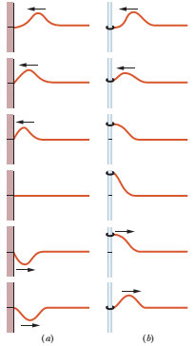
Lecture 21
Reflections at a Boundary:
Hard reflection: incident pulse is up and reflected pulse is down. reflected pulse is inverted. out of phase. destructive interference. node.
Soft reflection: incident pulse is up and reflected pulse is also up. reflected pulse is not inverted. in phase. constructive interference. antinode.
Fig. (a) Wall: hard reflection and (b) Rod: soft reflection

Slide 2
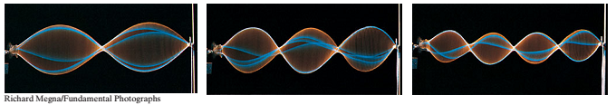
Standing waves and resonance:
Consider a string, such as a guitar string, that is stretched between two clamps. Suppose we send a continuous sinusoidal wave of a certain frequency along the string, say, toward the right. When the wave reaches the right end, it reflects and begins to travel back to the left. That left-going wave then overlaps the wave that is still traveling to the right.
For certain frequencies, the interference produces a standing wave pattern (or oscillation mode) with nodes and large antinodes like those in Fig. 16-20. Such a standing wave is said to be produced at resonance, and the string is said to resonate at these certain frequencies, called resonant frequencies.

Slide 3
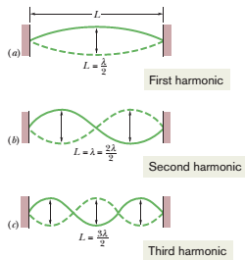
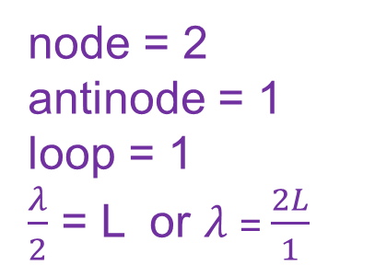
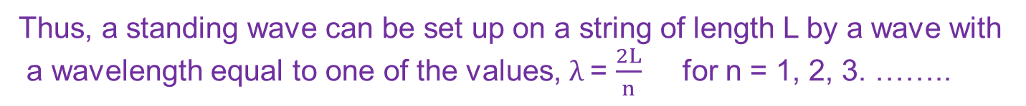
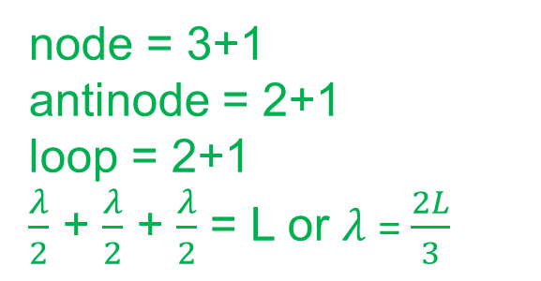
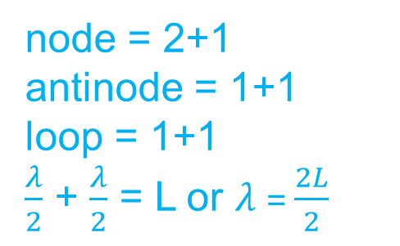
node = 2
antinode = 1
loop = 1
$\frac{λ}{2}$ = L or $λ$= $\frac{2L}{1}$
node = 2+1
antinode = 1+1
loop = 1+1
$\frac{λ}{2}$ + $\frac{λ}{2}$ = L or $λ$= $\frac{2L}{2}$
node = 3+1
antinode = 2+1
loop = 2+1
$\frac{λ}{2}$ + $\frac{λ}{2}$ + $\frac{λ}{2}$ = L or $λ$= $\frac{2L}{3}$
Thus, a standing wave can be set up on a string of length L by a wave with
a wavelength equal to one of the values, $λ$= $\frac{2L}{n}$ for n = 1, 2, 3. ……..

Slide 4




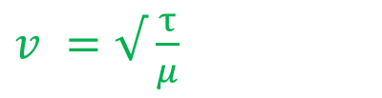


The resonant frequencies that corresponds to these wavelengths follow from the equation
v = f $λ$
f = $\frac{v}{\frac{2L}{n}}$
f = $\frac{n}{2L} v$
$v^{ }=√$ $\frac{τ}{μ}$
Resonant frequency, f = $\frac{n}{2L} √ \frac{τ}{μ }$
Oscillation mode: n = 1, 2, 3,………………..
If n = 1, f₁ = $\frac{1}{2L} \sqrt{ \frac{τ}{μ }} ; fundamenta mode or first harmonic$
If n = 2, f₂ = $\frac{2}{2L} \sqrt{ \frac{τ}{μ }} ; second harmonic$
If n = 3, f₃ = $\frac{3}{2L} \sqrt{ \frac{τ}{μ }} ; thrid harmonic$
https://www.youtube.com/watch?v=DUPLRe5PHvE

Slide 5
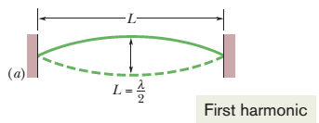
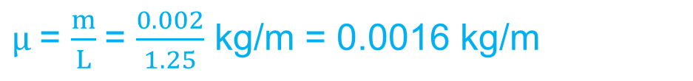

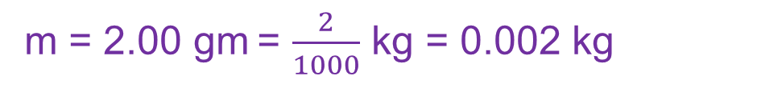

44. A 125 cm length of string has a mass 2.00 g and tension 7.00 N between fixed supports. (a) What is the wave speed for this string? (b) What is the lowest resonant frequency of this string?
Here, L = 125 cm = $\frac{125}{100}$ = 1.25 m
m = 2.00 gm = $\frac{2}{1000}$ kg = 0.002 kg
$τ$ = 7.00 N
$μ$= $\frac{m}{L}$= $\frac{0.002}{1.25}$ kg/m = 0.0016 kg/m
${\left(a\right) v}^{ }=√$ $\frac{τ}{μ}$ = $√$ $\frac{7.00}{\text{0.0016}}$ = $√$(4375) = 66.14 m/s Ans.
(b) For the lowest resonant frequency, n = 1: f = $\frac{n}{2L} √ \frac{τ}{μ }$
f₁ = $\frac{1}{2L} \sqrt{ \frac{τ}{μ }} =\frac{1}{2L} v= \frac{1}{2\left(1.25\right)}\left(66.14\right)=26.46 Hz Ans.$

Slide 6
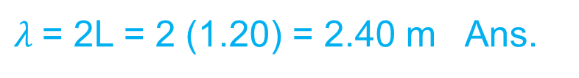
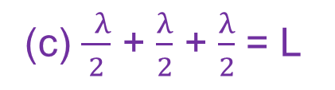
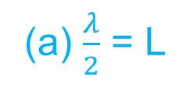

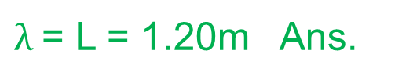
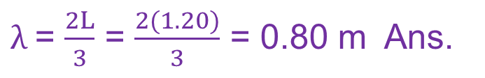
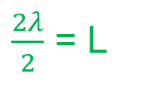
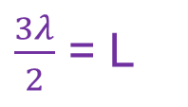
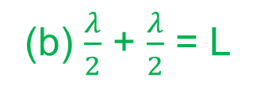
85. A 120 cm length of string is stretched between fixed supports. What are the (a) longest, (b) second longest, and (c) third longest wavelength for waves traveling on the string if standing waves are to be set up? (d) Sketch those standing waves.
Here, L = 120 cm = $\frac{120}{100}$ m = 1.20 m
(a) $\frac{λ}{2}$ = L
$λ$= 2L = 2 (1.20) = 2.40 m Ans.
(b) $\frac{λ}{2}$ + $\frac{λ}{2}$ = L
$\frac{2λ}{2}$ = L
$λ$= L = 1.20m Ans.
(c) $\frac{ λ}{2}$ + $\frac{λ}{2}$ + $\frac{λ}{2}$ = L
$\frac{3λ}{2}$ = L
$λ$= $\frac{2L}{3}$ = $\frac{2(1.20)}{3}$ = 0.80 m Ans.

Slide 7
Additional problem:
Sample problems 16.06, page: 469

